Slide 1
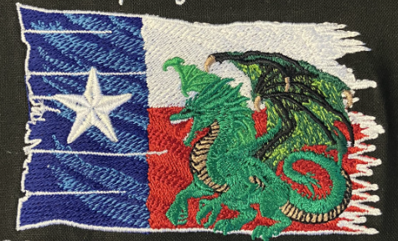
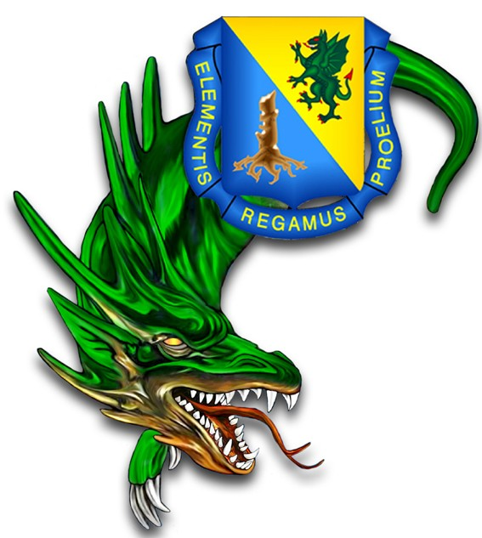
Chemical Corps Regimental Association (CCRA)
Lone Star Dragons Chapter
Who we are and our purpose!
Website: https://www.ccra-lsdragons.org

Slide 2
CCRA Lone Star Chapter
"Who we are"
We are a 501(c)3 organization (EIN: 82-4804235)
Our National CCRA headquarters is located at Fort Leonard Wood, MO; sixteen chapters are established in the US, South Korea, and Puerto Rico
Managed by an uncompensated Board of Directors (President, Vice President, Directors, Treasurer, and Historian)
Members are former and present Dragon Soldiers of all ranks across the state of Texas
Continuously seeking financial support to the Chapters mission in order to give back more to Dragon Soldiers and their families

Slide 3
CCRA Lone Star Chapter
"Purpose"
Support the national CCRA by promoting excellence, espirt de corps, and camaraderie among our chapter members, Dragon units, and communities
Honor and recognize our Chemical Corps history, comrades, chapter Gold Star families, and foster appreciation for their sacrifice and service
Support and provide charitable services for Dragon Soldiers and their families
Support mentorship and education of Dragon Soldiers
Continuously seek community partnerships, donor support, and Corporate memberships to enable the Chapter to give more to Dragon Soldiers and their families

Slide 4

CCRA Lone Star Chapter Six Pillars of Support
Support the Chemical Corps Strengthen the professional foundation of the Chemical Corps through advocacy of their mission and community engagement.
Approach: Build a solid foundation built on trust, exchange of ideas, and mutual interests Build strong state-wide partnerships with military CBRN units and community organizations
Notes:
Support to the Chemical Corps. Strengthening the professional foundation and technical expertise of the Corps through advocacy and resource alignment.
Support to Dragon Soldiers and Families. Enhancing the quality of life, resilience of "Dragon Soldiers" and their families through dedicated support, mentoring programs, and services.
Support to CBRN Units. Providing operational training, equipment modernization, and tactical support for Chemical, Biological, Radiological, and Nuclear defense units.
Support to Chemical Corps History (Museum in FLW, Mobile LS Chapter Museum). Preserving the legacy, artifacts, and stories of the Regiment to educate future generations of leaders.
Support to Veterans. Facilitating transitions to civilian life and ensuring continued connection to the Chemical Corps regimental community.
Support to Communities. Building strong local partnerships and providing assistance during domestic CBRN incidents or community outreach events.

Slide 5
CCRA Lone Star Chapter Six Pillars of Support
2. Support Dragon Soldiers and their Families Enhance the quality of life, resilience of "Dragon Soldiers" (Retired, Active Duty, Army Reserve, and National Guard) and their families.
Approach: Assist during deployments and domestic CBRN incidents (e.g. Care Packages, Cards) Provide support and services when requested Promote military/civilian mentorship
6. Support to Communities Building strong local partnerships and providing assistance during domestic CBRN incidents or community outreach events.
Notes:
Support to the Chemical Corps. Strengthening the professional foundation and technical expertise of the Corps through advocacy and resource alignment.
Support to Dragon Soldiers and Families. Enhancing the quality of life, resilience of "Dragon Soldiers" and their families through dedicated support, mentoring programs, and services.
Support to CBRN Units. Providing operational training, equipment modernization, and tactical support for Chemical, Biological, Radiological, and Nuclear defense units.
Support to Chemical Corps History (Museum in FLW, Mobile LS Chapter Museum). Preserving the legacy, artifacts, and stories of the Regiment to educate future generations of leaders.
Support to Veterans. Facilitating transitions to civilian life and ensuring continued connection to the Chemical Corps regimental community.
Support to Communities. Building strong local partnerships and providing assistance during domestic CBRN incidents or community outreach events.

Slide 6
CCRA Lone Star Chapter Six Pillars of Support
3. Support CBRN Units Promote morale boosting opportunities, appreciation/recognition of Dragon Soldiers and their families.
Approach: Family oriented Water/Fun Park Passes Movie Nights, Bowling Passes, Gym Memberships Gift Cards Specialized Dragon Awards
Notes:
Support to the Chemical Corps. Strengthening the professional foundation and technical expertise of the Corps through advocacy and resource alignment.
Support to Dragon Soldiers and Families. Enhancing the quality of life, resilience of "Dragon Soldiers" and their families through dedicated support, mentoring programs, and services.
Support to CBRN Units. Providing operational training, equipment modernization, and tactical support for Chemical, Biological, Radiological, and Nuclear defense units.
Support to Chemical Corps History (Museum in FLW, Mobile LS Chapter Museum). Preserving the legacy, artifacts, and stories of the Regiment to educate future generations of leaders.
Support to Veterans. Facilitating transitions to civilian life and ensuring continued connection to the Chemical Corps regimental community.
Support to Communities. Building strong local partnerships and providing assistance during domestic CBRN incidents or community outreach events.

Slide 7
CCRA Lone Star Chapter Six Pillars of Support
4. Support the Chemical Corps History Preserve the History, legacy, and artifacts of the Chemical Corps Regiment.
Approach: Promote a continual connection to the Chemical Corps LS Chapter Mobile Museum display (schools, installation/community engagements) Education of future generations of Dragon Leaders
Notes:
Support to the Chemical Corps. Strengthening the professional foundation and technical expertise of the Corps through advocacy and resource alignment.
Support to Dragon Soldiers and Families. Enhancing the quality of life, resilience of "Dragon Soldiers" and their families through dedicated support, mentoring programs, and services.
Support to CBRN Units. Providing operational training, equipment modernization, and tactical support for Chemical, Biological, Radiological, and Nuclear defense units.
Support to Chemical Corps History (Museum in FLW, Mobile LS Chapter Museum). Preserving the legacy, artifacts, and stories of the Regiment to educate future generations of leaders.
Support to Veterans. Facilitating transitions to civilian life and ensuring continued connection to the Chemical Corps regimental community.
Support to Communities. Building strong local partnerships and providing assistance during domestic CBRN incidents or community outreach events.

Slide 8
CCRA Lone Star Chapter Six Pillars of Support
5. Support Veterans Past and Present Honor our fallen Soldiers through community engagements.
Approach: Wreath laying at Veterans Cemeteries Pursue partnerships with Veteran Organizations (e.g. VFWs)
Notes:
Support to the Chemical Corps. Strengthening the professional foundation and technical expertise of the Corps through advocacy and resource alignment.
Support to Dragon Soldiers and Families. Enhancing the quality of life, resilience of "Dragon Soldiers" and their families through dedicated support, mentoring programs, and services.
Support to CBRN Units. Providing operational training, equipment modernization, and tactical support for Chemical, Biological, Radiological, and Nuclear defense units.
Support to Chemical Corps History (Museum in FLW, Mobile LS Chapter Museum). Preserving the legacy, artifacts, and stories of the Regiment to educate future generations of leaders.
Support to Veterans. Facilitating transitions to civilian life and ensuring continued connection to the Chemical Corps regimental community.
Support to Communities. Building strong local partnerships and providing assistance during domestic CBRN incidents or community outreach events.

Slide 9
CCRA Lone Star Chapter Six Pillars of Support
6. Support to Communities Participation in community outreach events.
Approach: Participation in Veterans Day Parades, Memorial Day Parades, or other shared patriotism events
Notes:
Support to the Chemical Corps. Strengthening the professional foundation and technical expertise of the Corps through advocacy and resource alignment.
Support to Dragon Soldiers and Families. Enhancing the quality of life, resilience of "Dragon Soldiers" and their families through dedicated support, mentoring programs, and services.
Support to CBRN Units. Providing operational training, equipment modernization, and tactical support for Chemical, Biological, Radiological, and Nuclear defense units.
Support to Chemical Corps History (Museum in FLW, Mobile LS Chapter Museum). Preserving the legacy, artifacts, and stories of the Regiment to educate future generations of leaders.
Support to Veterans. Facilitating transitions to civilian life and ensuring continued connection to the Chemical Corps regimental community.
Support to Communities. Building strong local partnerships and providing assistance during domestic CBRN incidents or community outreach events.

Slide 10

Conclusion and Points of Contact
Thank you for the opportunity to be part of and serve the Dragon Soldier families and our local communities.
It is an Honor and pleasure to serve and recognize our Dragon Soldiers and their families.
There is no greater calling than to Serve. Our partnership will only strengthen our shared bonds to serve our great nation, our state, and its Soldiers and families.
------------------------------------------------------------------------------
For donations, please contact: Mr. Kevin Kruise (CCRA LS Chapter Treasurer), email: kevin.o.kruise@gmail.com.
For Corporate Sponsorships please contact: Mr. Butch Striegl (CCRA LS Chapter President), email: conrad.striegl5@gmail.com
To donate, please visit our CCRA Lone Star Dragons Chapter Website: https://www.ccra-lsdragons.org or scan the QR code on the right to donate through Ziffy.com – a secure, no-fee website.

