Slide 1


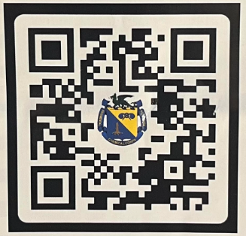
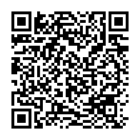

Chemical corps regimental association (CCRA)
Lone star chapter
Our chapter cannot effectively provide support without your help! Please consider donating to a great cause – our Dragon Soldiers! No amount is too small.
Why choose the CCRA Lone Star Chapter?
Become part of a team of current and retired chemical soldiers that are compassionate about serving the chemical corps, its Dragon Soldiers, and the communities in which they live
To make a donation to the CCRA Lone Star Chapter, please visit our website at www.ccra-lsdragons.org or scan the QR code below with your phone to donate through Ziffy.com.
Click on the QR Code to access online membership application. Select Lone Star Dragon (TX) from the Affiliation Chapter drop down menu. Remember your password.
For Corporate Sponsorships or donations contact: Mr. Butch Striegl (CCRA LS Chapter President), email: conrad.striegl5@gmail.com
CCRA National Website: https://www.ccrassn.org/memberships
Thank you for considering to become part of the Dragon Soldier family. It is an honor and pleasure to serve and recognize them for their sacrifice. There is no greater calling than to Serve. Our partnership will strengthen our shared bond to serve our great nation, our state, our communities, and the Soldiers and families that serve them.​
CONTACT US
CCRA Lone Star Chapter
PO Box 12078
Killeen, Texas 76547

Slide 2




Who we are
Multi-Layered approach of support
We are a 501(c)3 organization (EIN: 82-4804235)
NATional CCRA HQ's is located AT Fort Leonard Wood, MO; sixteen chapters are established in the US, South Korea, and Puerto Rico
Managed by an uncompensated Board of Directors (President, Vice President, Directors, Treasurer, and Historian)
Members are former and present Dragon Soldiers of all ranks across the state of Texas
Continuously seek financial support to the Chapters mission in order to give more to Dragon Soldiers and their families
CCRA Lone Star Chapter Six Pillars of Support
1. Approach:​
Build a solid foundation built on trust, exchange of ideas, and mutual interests​
Build strong state-wide partnerships with military CBRN units and community organizations
Support the Chemical Corps​:
Strengthen the professional foundation of the Chemical Corps through advocacy of their mission and community engagement.
2. Approach:​
Support during deployments and domestic CBRN incidents (e.g. Care Packages, Cards)​
Provide support and services as requested
Promote military/civilian mentorship
2. Support Dragon Soldiers and their Families​:
Enhance the quality of life, resilience of "Dragon Soldiers" (Retired, Active Duty, Army Reserve, and National Guard) and their families.
3. Approach:​
Family oriented Water/Fun Park Passes, Movie Nights, Bowling Passes, Gym Memberships​, Gift Cards​
Specialized Dragon Awards
3. Support CBRN Units:​
Promote morale boosting opportunities, appreciation/recognition of Dragon Soldiers and their families.
Our Purpose
4. Approach:​
Promote connection to the Chemical Corps​
LS Chapter Mobile Museum display (schools, installation/community engagements)​
Education of future generations of Dragon Leaders
4. Support the Chemical Corps History​:
Preserve the History, legacy, and artifacts of the Chemical Corps Regiment.
Support the national ccra by promoting excellence, esprit de corps, and camaraderie among our chapter members & sponsors, dragon units, and our communities
Honor and recognize our chemical corps history, comrades, chapter gold star families, and foster appreciation for their sacrifice and service
Support dragon soldiers and their families
Promote mentorship and education of dragon soldiers
5. Support Veterans Past and Present​:
Honor our fallen Soldiers through community engagements.
5. Approach:​
Wreath laying at Veterans Cemeteries​
Partnerships with Veteran Organizations (e.g. VFWs)
6. Support our Communities​:
Participation in community outreach events.
6. Approach:​
Participation in Veterans Day Parades, Memorial Day Parades, or other shared patriotic events

